Slide 1




Career path recommender
system
Najla Alduraib | Heleen Alshareef | Haneen Aljalal

Slide 2

INTRODUCTION
Choosing the right career can be a tough decision with so many options available. A Career Path Recommender System helps people, especially students and young professionals, find the best career paths based on their skills, interests, and hobbies.

Slide 3

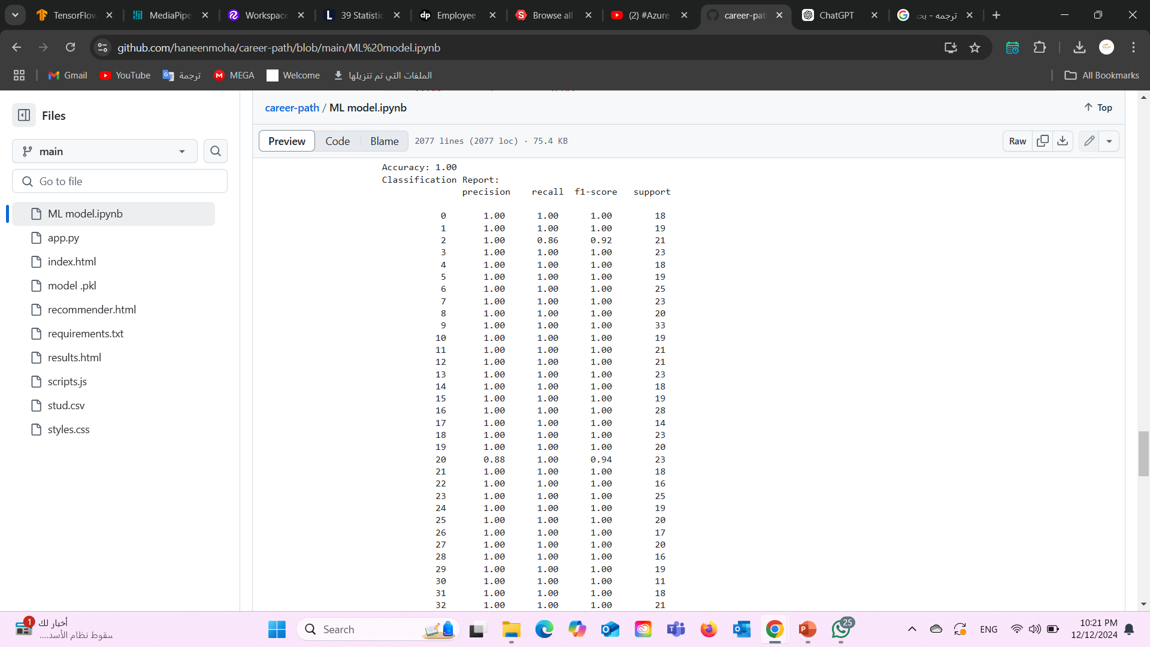
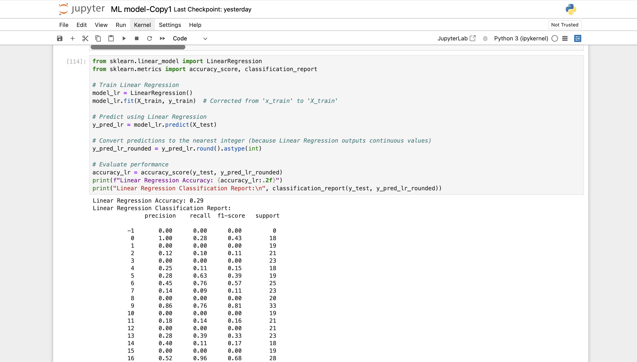
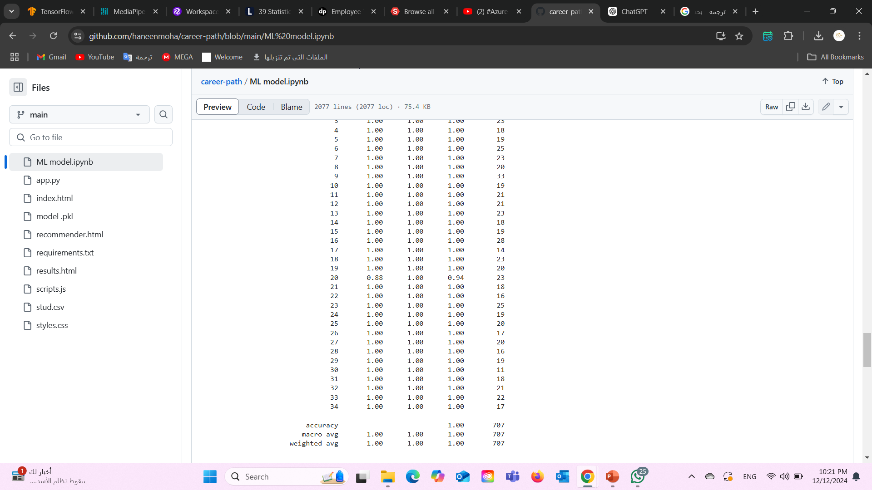
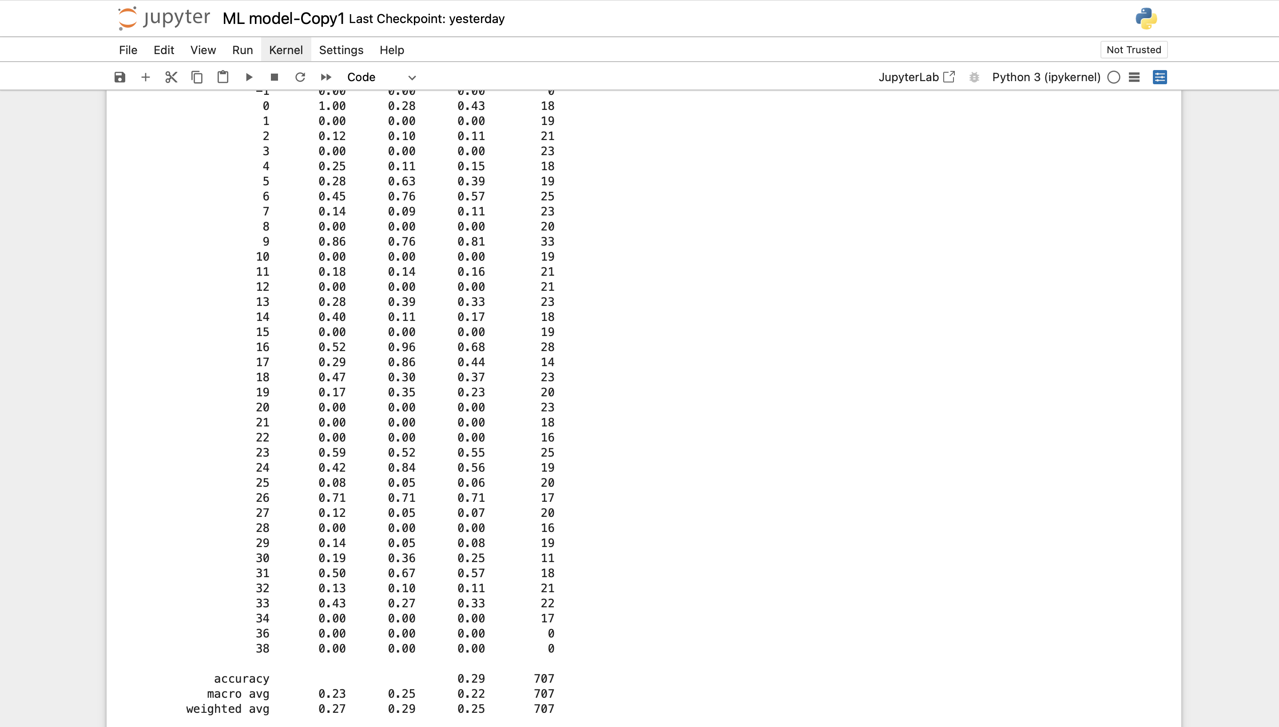
Linear
Result
Random Forest Model
Linear Regression Model

Slide 4

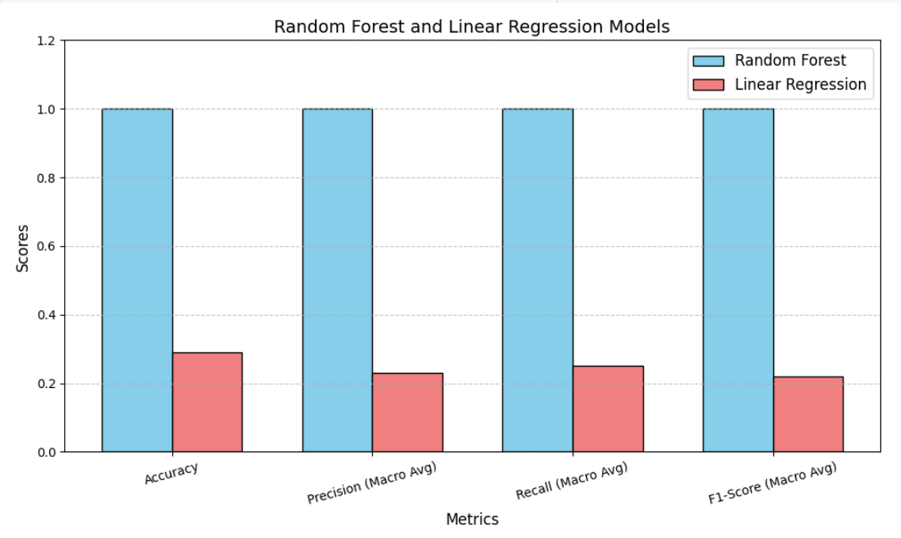
Bar chart

Slide 5
The different between RF and LR
1. Ability to Handle Complex Data: Systems dealing with complex patterns in data benefit from RF, which captures these complexities effectively, while LR struggles because it assumes a simple linear relationship.
2. Robustness to Noise and Outliers: Data may include inconsistencies or outliers, and RF handles these well by using multiple trees, while LR is more affected by outliers, which can distort results.
3. Feature Interactions: Many systems involve interacting variables, and RF can model these interactions naturally, while LR cannot handle them unless explicitly defined.
4. Superior Performance: RF often achieves higher accuracy due to its ability to model complex patterns, while LR may perform poorly in such scenarios because of its linear assumptions.

Slide 6
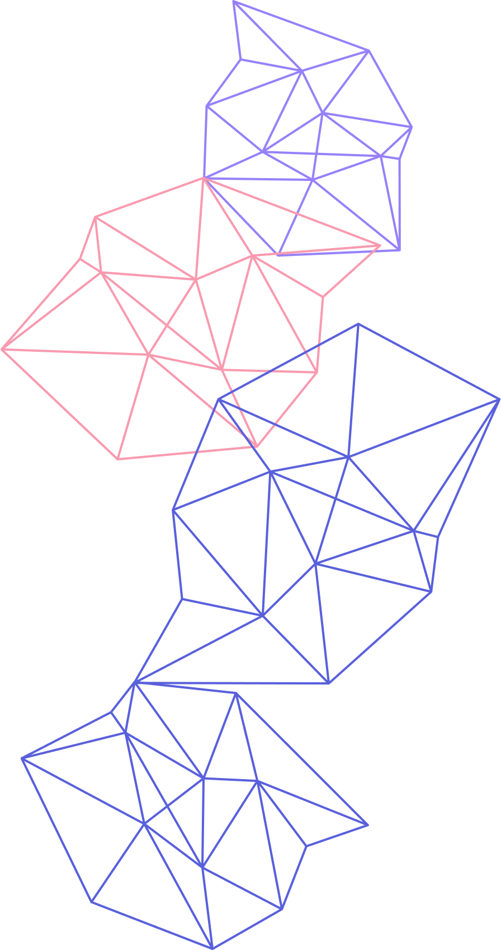
Why Random Forest is better
Random Forest (RF) is great at handling complex, non-linear relationships in data, meaning it can identify patterns that are not simple or straightforward. It is also very good at dealing with noisy data, which is common in real-world situations where the data may contain errors or irrelevant information. Since RF combines the results of many decision trees, it reduces the risk of overfitting and performs better when making predictions on new, unseen data. These strengths make Random Forest a strong choice for our Carer System, especially when we need reliable and accurate results from complex and varied data.

Slide 7
THANK
YOU!

